Slide 1
Synchronous Sequential Circuits
Lecture_12a_Design of counter using sequential circuit approach
Reference: Chapter 8, section 8.7, page 495, Stephen Brown, ZvonkoVranesic, “Fundamentals of Digital Logic with VerilogDesign”, Tata McGraw Hill Publishing Company Limited, Second Edition

Slide 2

Let us start with designing a counter!! (using FSM approach)
Specification for the counter is:

Slide 3
Design steps:(same for any designs using FSM approach)
1) state diagram
2) state table
3) state assignment table
4) find equations and
5) implement the circuit
Better to have (not necessary): Black box of circuit you are planning to design before step 1
??
w
Inputs to the circuit
Outputs of the circuit
clock

Slide 4
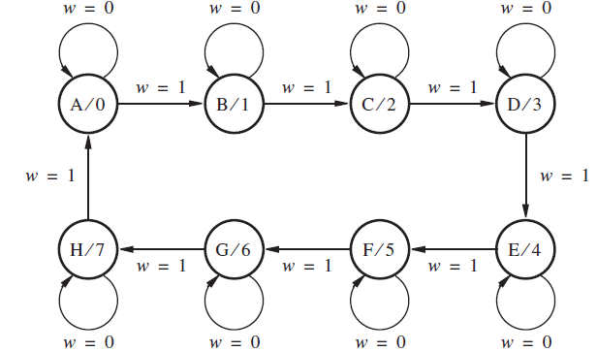
1) state diagram
Points to note:
1) decimal values of counter outputs can be written along with state labels in these cases

Slide 5
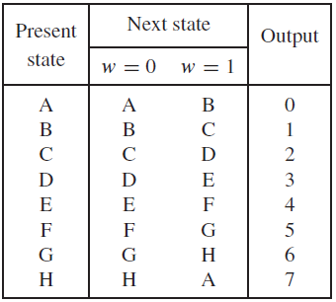
2) state table
Points to note:
1) decimal values of counter outputs can be written along with output column in these cases

Slide 6
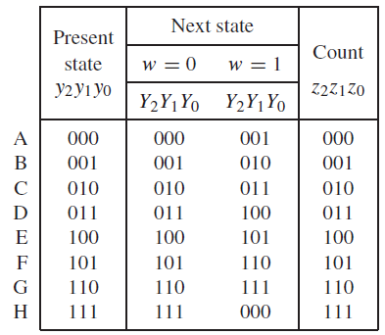
3) state assignment table
Points to note:
1) binary values of counter outputs are written.
compare present state column and Count column.
2) as far as possible, the binary of count (last column) is given to present state variables (first column), so here first column and last column are exactly same)

Slide 7
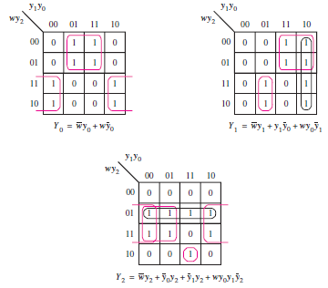

4) find equations
Points to note:
1) default Flipflop to be used in counter design (when you are using FSM approach) is D-Flip-flops.
2) logic at input side of all D Flip-flops is obtained from equations.

Slide 8
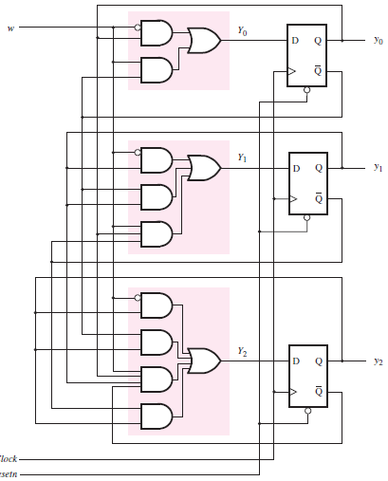
5) implement the circuit
Points to note:
1) take the required type of D-FF for implementation

Slide 9
Homework
1) For a counter circuit, the output sequence changes according to values of input signal 'm'. When 'm'=0 output remains same and when 'm'=1, counter increments output by 1. output sequences for the counter are: 0, 1, 2, 3, 4, 5, 0, 1, 2, …...
Hint: Use don't cares for unused state variable combinations.
2) For a counter circuit, the output sequence changes according to values of input signal 'w'. When 'w'=0 output remains same and when 'w'=1, counter increments output by 1. output sequences for the counter are: 6, 5, 4, 3, 2, 1, 6, 5, 4, …...
Hint: Use don't cares for unused state variable combinations.

